Slide 1

International Certified Crop Adviser
Fall Board Meeting
Program Update
September 25-26, 2024
Dawn Gibas, PhD, CPSS
Director of Certifications

Slide 4
2023 Numbers:
CCAs 12,871
CPAgs 400
CCA Retired 356
CPAg Retired 29
CCA Candidates 82
4R NMS 493
SSp 151
RMS 158
PASp 174
MM 21
CA NSp 904
2022 Numbers:
CCAs 13,347
CPAgs 436
CCA Retired 370
CPAg Retired 30
CCA Candidates 133
4R NMS 478
SSp 149
RMS 151
PASp 161
MM 20
CA NSp 899

Slide 7

What did we accomplish this year?
Virtual Meetings
Voting on policy during virtual meetings
  Amnesty, CEUs, Ethics CEU, Complaint Investigation Procedure, Logo
Increased communication
  In the Know delivered monthly
  The Adviser delivered every other month
  Increased communication between customer support center and admins
  Increased discussion of issues
  Executive Committee members visiting more with Local Boards
Marketing Discussion Group
Discussion Board for Admins

Slide 8
What did we accomplish this year?
CCA Survey on membership
ASA/ICCA discussions on membership
MOU with NRCS for the TSP Program
Congressional Visit Days
Updating Policy and Procedure Manual
Increase in exam numbers from 2023
Introduced Section Testing
Mexico is now window testing/remote proctor
Welcoming Brazil CPAE to the
  CCA Program

Slide 9

ICCA Board Meeting
Exam Update

Slide 10
ASA/SSSA Certification Program Goals
Consistency and Standardization Across all Exams.
Compliance with Accepted Standards for Credentialing Exams.
Operate and Maintain an Exam Program that is Legally Defensible.

Slide 11
Exam Program Overview
Larger number of exams with window testing and maybe with sections.
Exam Program is growing:
Brazil
Mid Atlantic NM
South Florida/Caribbean
International Opportunities
Need to revisit the discussion of combining local board exams with similar agriculture.
*also in strategic plan

Slide 12
IBT starts
COVID

Slide 13
2024 Exam Registrations through August
Arkansas | 8 |  | Mid-Atlantic | 7+ |  | Ohio | 44+
Atlantic Provinces | 7 |  | Soil and Water Mgmt | 1 |  | Nutrient Management | 1
Colorado | 6 |  | Pest Management | 1 |  | Soil and Water Mgmt | 1
Florida | 2 |  | Minnesota | 26 |  | Pest Management | 1
Illinois | 69 |  | Mississippi | 3 |  | Crop Management | 1
Indiana | 25+ |  | Missouri | 22 |  | Oklahoma | 8
Nutrient Management | 1 |  | Nebraska | 19 |  | Ontario | 40+
Crop Management | 1 |  | North Carolina | 11+ |  | Nutrient Management | 1
Iowa | 42 |  | Nutrient Management | 1 |  | Soil and Water Mgmt | 1
Kansas | 7 |  | Pest Management | 1 |  | Pest Management | 1
Kentucky | 16 |  | North Dakota | 17 |  | Crop Management | 1
Louisiana | 3 |  | Northeast | 18+ |  | Pennsylvania | 7
Michigan | 12+ |  | Nutrient Management | 1 |  | Prairie Provinces | 113+
Nutrient Management | 1 |  | Crop Management | 1 |  | Nutrient Management | 3
Soil and Water Mgmt | 1 |  | Northwest | 30 |  | Soil and Water Mgmt | 3
Pest Management | 1 |  |  |  |  | Pest Management | 2
Crop Management | 1 |  |  |  |  | Crop Management | 2

Slide 14
2024 Exam Registrations through August
 |  |  | Rocky Mountain | 7
 |  |  | South Carolina | 3
 |  |  | South Dakota | 12
 |  |  | Southeast | 9+
 |  |  | Nutrient Management | 1
 |  |  | Soil and Water Mgmt | 1
 |  |  | Pest Management | 1
 |  |  | Crop Management | 1
 |  |  | Tennessee | 5
 |  |  | Texas | 7
 |  |  | Western Region | 78+
 |  |  | Nutrient Management | 2
 |  |  | Soil and Water Mgmt | 1
 |  |  | Crop Management | 1
 |  |  | Wisconsin | 36

Slide 15
MonitorEDU –
Improved Experience
Front facing and side camera views
Easier connecting with proctor
Easier launching the exam
Spanish speaking proctors
Less foreign accents

Slide 16

Exams
Exam Committees follow the Exam Process.
Work depends on the exam status.
Meet every other week.
Will run an item analysis when numbers make sense
  Many were run this year in anticipation of providing feedback to exam committees.
  Hadn’t been run since February 2002.
  Not everyone was done, it depended on the number of exams.
Exam committees should have at least 5 preferably more members that represent the state, region, or province.
  Mix of expertise, geography, workplace, degree level.
Many committees will be meeting in 2025, please make sure Michele Lovejoy has an updated committee list.

Slide 17
Moving Forward with Exams
Where does AI fit in?
Work on increased statistical analysis.
Increase exam numbers and retention
Evaluate the section testing program.

Slide 18

FFA CCA Apprentice
FFA CCA Apprentice Exam Program
Exam Committee is active
  Uses ICCA POs
  60 questions
  This will be the 3rd year the exam is used
  Only available at the National Convention as part of the Agronomy CDE
2022 – 24 passed the exam, 2023 28 passed
Currently 20 students have accepted the CCA Apprentice status.
More to come on the overall work with FFA this afternoon with Isaac and Luther.

Slide 19
Staff related to Certifications/Exams
Jim Cudahy – CEO
Luther Smith – CAO
Dawn Gibas – Director of Certifications
  Michele Lovejoy – Lead Exam Operations Representative
Sara Uttech – Director of Governance
Lacey Edwardson – Support Center Lead/Marketing Liaison
  Penny Magana – Certification Representative
  Matthew Davey (Davey) – Certification Representative
Other support: Marketing (Hanna Jeske)
          Webinars (Jamie Nix)
        Education/Publications (Matt Wascavage)

Slide 20

ICCA Board Meeting
Policy & Procedures Manual

Slide 21

Updated Policy & Procedures Manual
The ICCA Board has voted on all of the Policy changes.
  Amnesty
  CEUs
  Ethics CEU
  Complaint Investigation Procedure
Remainder is Procedures that staff is updating.
Updated document is planned to be released by the end of December 2024.

Slide 22
Discussion on Structure of Board
In 2010, the ICCA Program Board structure was changed to the following:
CCA – International Council – sets overall policies for the program and deals with issues that impact the entire program regardless of international boundaries. The Council is comprised of the three ICCA executives, ICCA representative to the ASA board, ASA Board executive committee representative and a representative from each CCA - National Board. The Council meets as needed.
CCA – National Board – sets policies and deals with issues that are unique to an individual country. It also ratifies policy decisions made by the CCA – International Council. Each CCA – Local Board has one representative on its respective CCA - National Board along with representatives from the appropriate government agencies associated with agriculture, resource management and environmental protection. The National Boards meet as needed.
CCA – Local Board – administers the ICCA Program at the state, regional or provincial level.
In 2013, the ICCA Program moved from a standing committees’ structure to a task force structure. Task Forces are appointed by the ICCA Board Chair, serve as needed and for the time needed to complete their task. Rapid Response Teams (RRT) were enacted for the four competencies’ areas: Nutrient Management; Soil and Water Management; Integrated Pest Management; and Crop Management comprised of members from the ASA Communities by the same name. RRTs serve as needed. The ICCA executive committee serves as the Budget and Finance Committee.
Each voting member of the ICCA Board representing a local CCA board will need to be a CCA and a current member of the local board. The representative automatically in this position is the local CCA board chair unless the local board designates another member and notifies the ICCA office.
In 2015, the program included the three countries of North America (USA, Canada, Mexico) and began meeting as such under the title of ICCA Board. It will continue to do so until additional countries are added to the program.

Slide 23

ICCA Board Meeting
Strategic Plan Update for 2026-2028

Slide 24
2023 – 2025 ICCA Strategic Plan
ICCA Goals
GOAL A: Promote the value of the CCA Certification.
GOAL B: Increase collaboration with key stakeholders to grow the recognition of CCAs as leaders in the industry and provide a bridge between science, production and certification end-users.
GOAL C: Increase Participation of CCA’s in local, national and international boards and committee activities.

Slide 25
GOAL A: Promote the value of the CCA Certification.
Objective #1: Maintain robust marketing effort around the awareness of the ICCA program.
Strategies:
  1. Develop marketing plan for farmers, encouraging cooperation with grower and commodity groups for promotion of CCA.
  2. Expand relationships with employers.
  3. Expand relationships through enhanced outreach with universities, community colleges, tech schools, FFA, 4H and other youth-oriented activities through student exams, CCA Apprentice and Candidate status programs.
  4. Expand relationships with Extension personnel.
Objective #2: Ensure the use of emerging information delivery technologies.
Strategies:
  1. Keep current on available social media sites to advertise available CEUs and find new opportunities to promote CCA.
  2. Develop online discussion groups for CCAs who are members of ASA and also for those who are not and are only CCA.
  3. Look for new and innovative remote learning opportunities.
Objective #3: Promote the value of certification to CCAs.
Strategies:
  1. Engage CCAs in processes to provide assurance of environmental quality to consumers and the public.
  2. Communicate the benefits of ASA membership, relationship and resources to CCAs.
  3. Promote CCA program to practicing agronomist members of ASA.
  4. Communicate the ROI for CCAs.
  5. Enhance visibility of CCAs in appropriate media outlets.

Slide 26
GOAL B: Increase collaboration with key stakeholders to grow the recognition of CCAs as leaders in the industry, provide a bridge between science, production and end users.
Objective #1: Identify stakeholders by:
  a. Science
  b. Production
  c. End users (farmers, landowners)
Objective #2: Develop and implement a plan on how to effectively work with stakeholders for a mutually beneficial relationship.
Objective #3: Evaluate the effectiveness and value of stakeholders that approach the ICCA Program.
Objective #4: Continue to work with and expand alliances with the American Society of Agronomy (ASA) and third-party education programs.
Strategies:
  1. Reach out and work with universities, researchers, extension, and industry to expand CEU opportunities to maintain current and relevant science.
Objective #5: Recognize stakeholders’ support of the ICCA program.
Strategies:
  1. Develop a recognition plan for employers, academic institutions, CPG (Consumer Packaged Goods companies) and government agencies as appropriate.

Slide 27
GOAL C: Increase participation of CCAs in local, national and international boards and committee activities.
Objective #1: Investigate and develop if needed a CCA focused Congressional Visits Day.
Strategies:
1. Charge ICCA Policy Committee with completing objective.
Objective #2: Investigate and develop if determined viable a CCA focused annual meeting.
Strategies:
1. Form a task force to perform this function.
Objective #3: Charge the ICCA Exam Committee with exploring the potential of merging local exam committees and exams where feasible.

Slide 28

2026 Update to ICCA Strategic Plan
Need a Task Force to begin work on the 2026-2028 Plan.
  Review 2023-2025 Plan
    Accomplishments
    Short falls
  New/updated goals and objectives
Outline for next Strategic Plan.
Presentation this time next year.

Slide 29
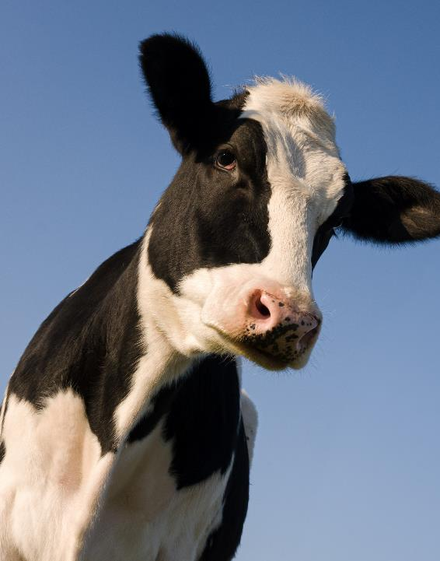
Looking forward to a great meeting with a lot of conversation and interaction!
Questions/Discussion?
Thank you! Please feel free to
contact me at any time.
Dawn Gibas, PhD, CPSS
Director of Certifications
dgibas@sciencesocieties.org

